Slide 1

Anvisys Technology Pvt. Ltd
Your Trusted IT Solution and Consulting Partner
Office address: 63 Noida,Uttar Pradesh, H Block,Sector
www.Anvisys.online
Number: 9591033223

Slide 2
Our Mission
To be preferred IT partner
Helping client the achieve their goals
Match with the latest Technology
Maintain a dynamic and Skilled Team.

Slide 3
Emerging need of a reliable IT support.
Upgrade & Maintenance
Problem Solving Solution
Solve various problems like database-management coding developing & testing
Technical Support
data maintenance & analysing
Efficient backend support
THINK
BIGGER
Steady Growth
Working in integration with all the levels of your

Slide 4
Our Offering
WE AIM TO MAINTAIN A LONG TERM RELATION WITH OUR CLIENTS
End to End Software Solutions
Android , Desktop, Web, DB
Staffing – Software Professionals
Services
Geographical Information System(GIS
Software Testing
Notes:
Types of services we offer

Slide 5
Software Services
Services Include
Web Application
Database Designing
Android Application
Microservices and Service
Non-Functional
Architecture: Monolithic, SOA, Microservice
Security: Database level, OAuth, SSL, Cloud Security
Methodology: Agile, Waterfall, Iterative
Web service
Web Client
HTTP request
JSON/XML
MobileDevice
Desktop
Database

Slide 6
Our Clients
Egis India.
Pinnacle Geo-system
Dr. Sundeep Goyal
BHEL, Haridwar
Advisory On Demand
Nestin

Slide 7


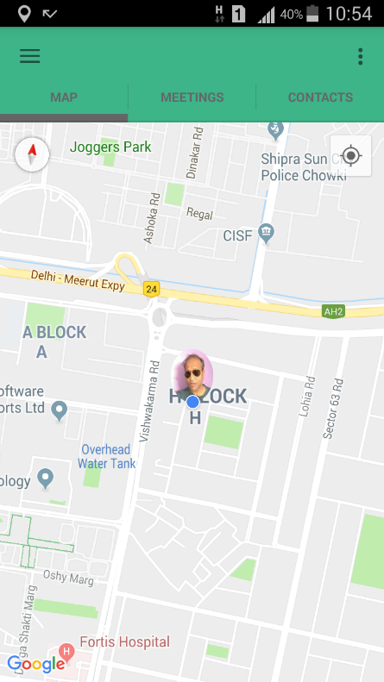
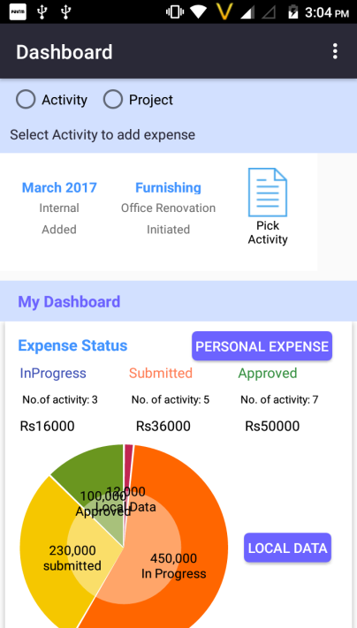
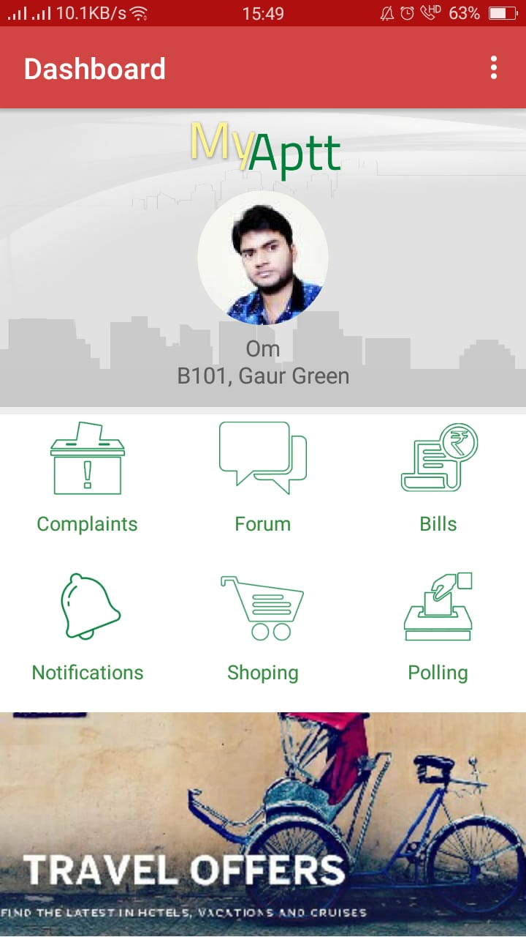
Our Products
PRODUCT 2
X- PEN
Let’s Catch-up
PRODUCT 1
Locate your friends
Society Management System
3
Share your location with your friends
Receive location shared by your friends
Our products
2
1

Slide 8

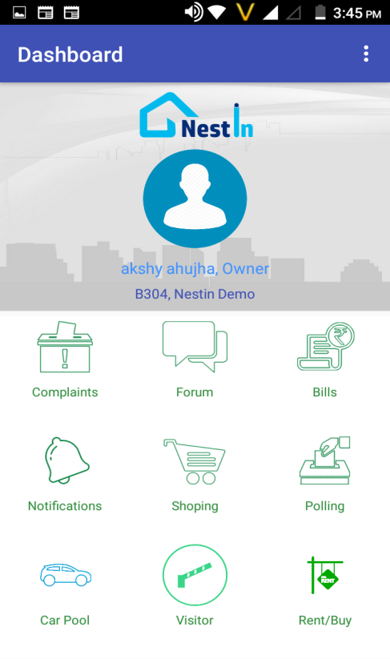
A Complete Society Management System
• Visitor Management
• Visitor Management
• Vendor Directory
• Vendor Directory
• Complaint Management
• Notice Board
• Complaint Management
• Notice Board
• SMS Notification
• Rent in & Rent Out
• Forum & Discussions
• SMS Notification
• Rent in & Rent Out
• Forum & Discussions

Slide 9
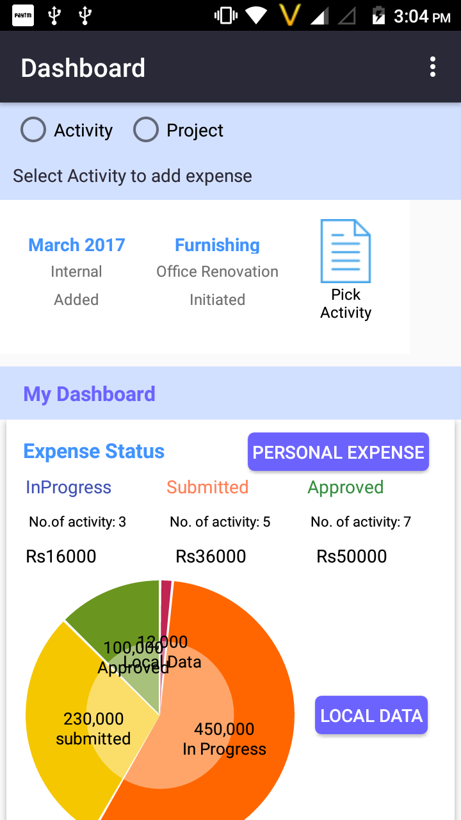
X- PEN
17,987
Expense and Accounting Management for personal and organization needs
9,9871
+120%
+150%
+110%
-50%
5,9871
7,9871
-30%
Projects Sale, purchase entries by Project Manager
Salary, Capex and other transaction by Accounts
3,9871

Slide 10
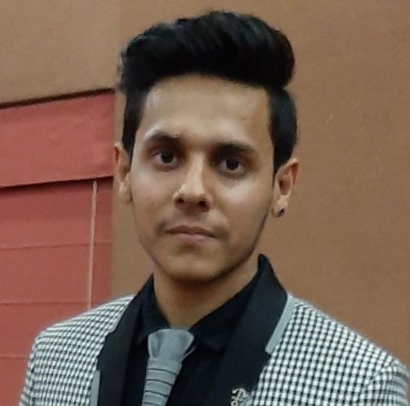
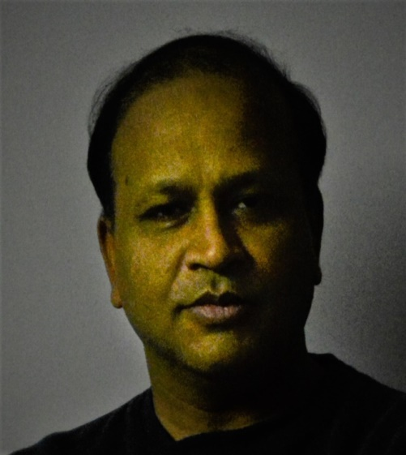
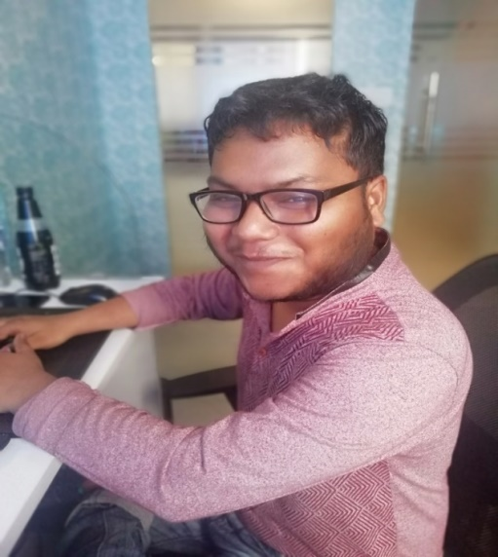
Meet the Team
Amit Bansal
Sagar Srivastava
Shivang Bhatnagar
DI R EC T O R M.Tech.- IIT Roorkee
A N D O I D DEVE L O P E R
W E B DE V E LO P E R
B.E. Computer Science
B.E. Computer Science
18 Years Experience
3 Year Experience
2 Year Experience

Slide 11
Anvisys Technology Pvt. Ltd
Your Trusted IT Solution and Consulting Partner
Office address: 63 Noida,Uttar Pradesh, H Block,Sector
www.Anvisys.online
Number: 9591033223

Slide 12
Our Mission
Anvisys Technology Pvt. Ltd
We aim to be the most preferred IT partner to our clients by helping the achieve their goals
We focus on our client’s goal & provide the latest technology
Anvisys is about providing a platform to our team members to learn & grow.

Slide 13
Anvisys Technology Pvt. Ltd
Problem Solving Solution
data maintenance & analysing
Upgrade & Maintenance
Technical Support
THINK
BIGGER
Solve various problems like database-management coding developing & testing
Efficient backend support
Steady Growth
Working in integration with all the levels of your

Slide 14
Anvisys Technology Pvt. Ltd
WE AIM TO MAINTAIN A LONG TERM RELATION WITH OUR CLIENTS
End to End Software Solutions
Android , Desktop, Web, DB
Staffing – Software Professionals
Services
Geographical Information System(GIS
Software Testing
Notes:
Types of services we offer

Slide 15
Xml for UI, Core Java for Business Logic, API or services to read/write data Android Studio : Native Android Development tool
Android Application
1
Html
CSS
Java Script
Web Application
2
Word press Angular JS
Angular 4.0
ASP.net
Desktop Application
3
MYSQL
Mongo DB
SQLServer
Database Designing
4
Anvisys Technology Pvt. Ltd
Notes:
What we do ?

Slide 16
Anvisys Technology Pvt. Ltd
Result web service
Small size solutions of team of 5 to 10 resources:
Web Application
Database Designing
Android Application
Microservices and Service
Non Functional
Architecture: Monolithic, Service Oriented Architecture, Microservice Architecture
Security: Database level, OAuth, SSL, Cloud Security
Methodology : Agile, Waterfall, iterative
Web service
Client
HTTP request
JSON/XML
Device
Web Apps Desktop
Database

Slide 17
Anvisys Technology Pvt. Ltd
Software Solutions we Offer
Desktop Application
Android Application
Database Designing
Web Application

Slide 18







Our area of expertise
Support area’s
Anvisys Technology Pvt. Ltd
Notes:
The content is to be added .kindly review it

Slide 19
Anvisys Technology Pvt. Ltd
Our Clients
Egis India.
Pinnacle Geo-system
Dr. Sundeep Goyal
BHEL, Haridwar
Advisory On Demand
Nestin

Slide 20
Anvisys Technology Pvt. Ltd
PRODUCT 3
PRODUCT 2
X- PEN
PRODUCT 2
Let’s Catch-up
PRODUCT 1
PRODUCT 1
Expense and Accounting Management
Projects Sale, purchase entries by Project Manager
NESTIN
Share your location with your friends
Receive location shared by your friends
Get the Route, Location and Time Difference
3
Share your location with your friends
Receive location shared by your friends
Our products
Society Management System
Car pooling
Security for society
Vendor management
2
1

Slide 21
Anvisys Technology Pvt. Ltd
A Complete Society Management System
• Visitor Management
• Vendor Directory
• SMS Notification
• Rent in & Rent Out • Sale & Purchase
• Notice Board
• Forum & Discussions
• Complaint Management

Slide 22

Anvisys Technology Pvt. Ltd
Let’s Catch-up
Share your location with your friends
Receive location shared by your friends
.
Get the Route, Location and Time Difference
Notes:
Now track your close ones by Let’s catch-up. With live tracking and location sharing .

Slide 23
Anvisys Technology Pvt. Ltd
+150%
X- PEN
17,987
9,9871
Expense and Accounting Management for personal and organization needs
+120%
+110%
-50%
5,9871
7,9871
-30%
3,9871
Salary, Capex and other transaction by Accounts
Projects Sale, purchase entries by Project Manager

Slide 24

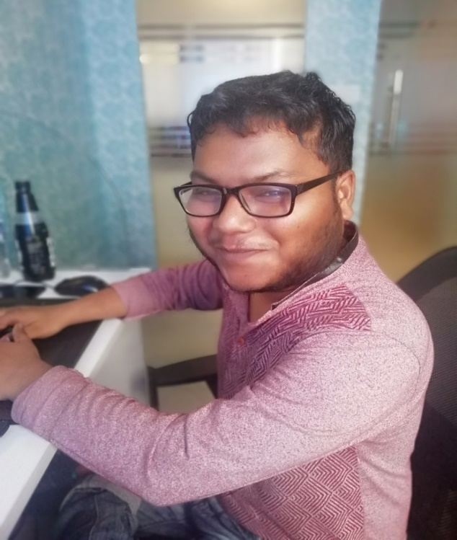

Anvisys Technology Pvt. Ltd
Amit Bansal
Sagar Srivastava
Shivang Bhatnagar
DI R EC T O R M.Tech.- IIT Roorkee
A N D O I D DEVE L O P E R
W E B DE V E LO P E R
B.E. Computer Science
B.E. Computer Science
18 Years Experience
3 Year Experience
2 Year Experience

Slide 26
Anvisys Technology Pvt. Ltd
Your Trusted IT Solution and Consulting Partner
Office address: 63 Noida,Uttar Pradesh, H Block,Sector
www.Anvisys.online
Number: 9591033223

Slide 27
Our Mission
Anvisys Technology Pvt. Ltd
We aim to be the most preferred IT partner to our clients by helping the achieve their goals
We focus on our client’s goal & provide the latest technology
Anvisys is about providing a platform to our team members to learn & grow.

Slide 28
Anvisys Technology Pvt. Ltd
Problem Solving Solution
data maintenance & analysing
Upgrade & Maintenance
Technical Support
THINK
BIGGER
Solve various problems like database-management coding developing & testing
Efficient backend support
Steady Growth
Working in integration with all the levels of your

Slide 29
Anvisys Technology Pvt. Ltd
WE AIM TO MAINTAIN A LONG TERM RELATION WITH OUR CLIENTS
End to End Software Solutions
Android , Desktop, Web, DB
Staffing – Software Professionals
Services
Geographical Information System(GIS
Software Testing
Notes:
Types of services we offer

Slide 30
Xml for UI, Core Java for Business Logic, API or services to read/write data Android Studio : Native Android Development tool
Android Application
1
Html
CSS
Java Script
Web Application
2
Word press Angular JS
Angular 4.0
ASP.net
Desktop Application
3
MYSQL
Mongo DB
SQLServer
Database Designing
4
Anvisys Technology Pvt. Ltd
Notes:
What we do ?

Slide 31
Anvisys Technology Pvt. Ltd
Result web service
Small size solutions of team of 5 to 10 resources:
Web Application
Database Designing
Android Application
Microservices and Service
Non Functional
Architecture: Monolithic, Service Oriented Architecture, Microservice Architecture
Security: Database level, OAuth, SSL, Cloud Security
Methodology : Agile, Waterfall, iterative
Web service
Client
HTTP request
JSON/XML
Device
Web Apps Desktop
Database

Slide 32
Anvisys Technology Pvt. Ltd
Software Solutions we Offer
Android Application
Desktop Application
Web Application
Database Designing

Slide 33
Anvisys Technology Pvt. Ltd
We area of expertise
Support area’s
Notes:
The content is to be added .kindly review it

Slide 34
Anvisys Technology Pvt. Ltd
Egis India.
Our Clients
Pinnacle Geo-system
Dr. Sundeep Goyal
BHEL, Haridwar
Advisory On Demand
Nestin

Slide 35
Anvisys Technology Pvt. Ltd
PRODUCT 3
X- PEN
PRODUCT 2
PRODUCT 2
PRODUCT 1
Let’s Catch-up
Expense and Accounting Management
Projects Sale, purchase entries by Project Manager
PRODUCT 1
NESTIN
Share your location with your friends
Receive location shared by your friends
Get the Route, Location and Time Difference
3
Share your location with your friends
Receive location shared by your friends
Our products
Society Management System
Car pooling
Security for society
Vendor management
2
1

Slide 36
Anvisys Technology Pvt. Ltd
A Complete Society Management System
• Visitor Management
• Vendor Directory
• SMS Notification
• Rent in & Rent Out • Sale & Purchase
• Notice Board
• Forum & Discussions
• Complaint Management

Slide 37
Anvisys Technology Pvt. Ltd
Let’s Catch-up
Share your location with your friends
Receive location shared by your friends
.
Get the Route, Location and Time Difference
Notes:
Now track your close ones by Let’s catch-up. With live tracking and location sharing .

Slide 38
Anvisys Technology Pvt. Ltd
+150%
X- PEN
17,987
9,9871
Expense and Accounting Management for personal and organization needs
+120%
+110%
-50%
5,9871
7,9871
-30%
Projects Sale, purchase entries by Project Manager
Salary, Capex and other transaction by Accounts
3,9871

Slide 39
Anvisys Technology Pvt. Ltd
Amit Bansal
Sagar Srivastava
Shivang Bhatnagar
DI R EC T O R M.Tech.- IIT Roorkee
A N D O I D DEVE L O P E R
W E B DE V E LO P E R
B.E. Computer Science
B.E. Computer Science
18 Years Experience
3 Year Experience
2 Year Experience

